Slide 1
GAIT Analysis
To predict chronic disorder using Android Smartphone
Vighnesh Misal
Nahush Raichura
Rishi Joshi
Arjun Jaiswal

Slide 2
GAIT Analysis
Analyze the way in which a person moves i.e their posture, movement of arms and feet, walk speed etc
This can be used to predict the occurrence of neuro-degenerative disorders.

Slide 3
Goal
Provide a cheaper, reliable and flexible alternative to the technologies currently available in the market by using smartphone sensors to measure people’s GAIT

Slide 4
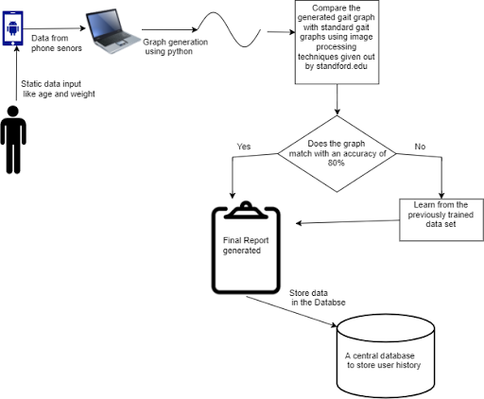
Implementation Diagram

Slide 5
Use of Smartphones
Data Acquisition
Feature Extraction
Classifier Design

Slide 6
Implementation Steps
Strap a smartphone in strategic positions around the body to measure GAIT variables
Sensor data is retrieved and used to construct graphs in MATLAB for comparison with normal GAIT graphs
Anomalies are compared with trained data sets from various disease to arrive at the result

Slide 7
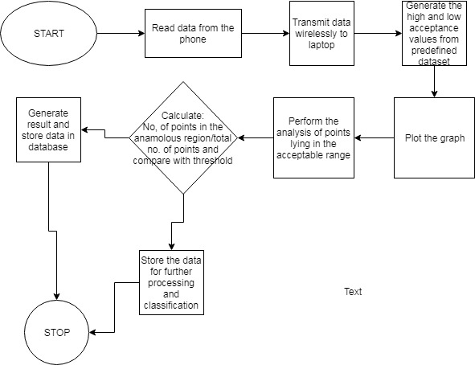
System Architecture

Slide 8
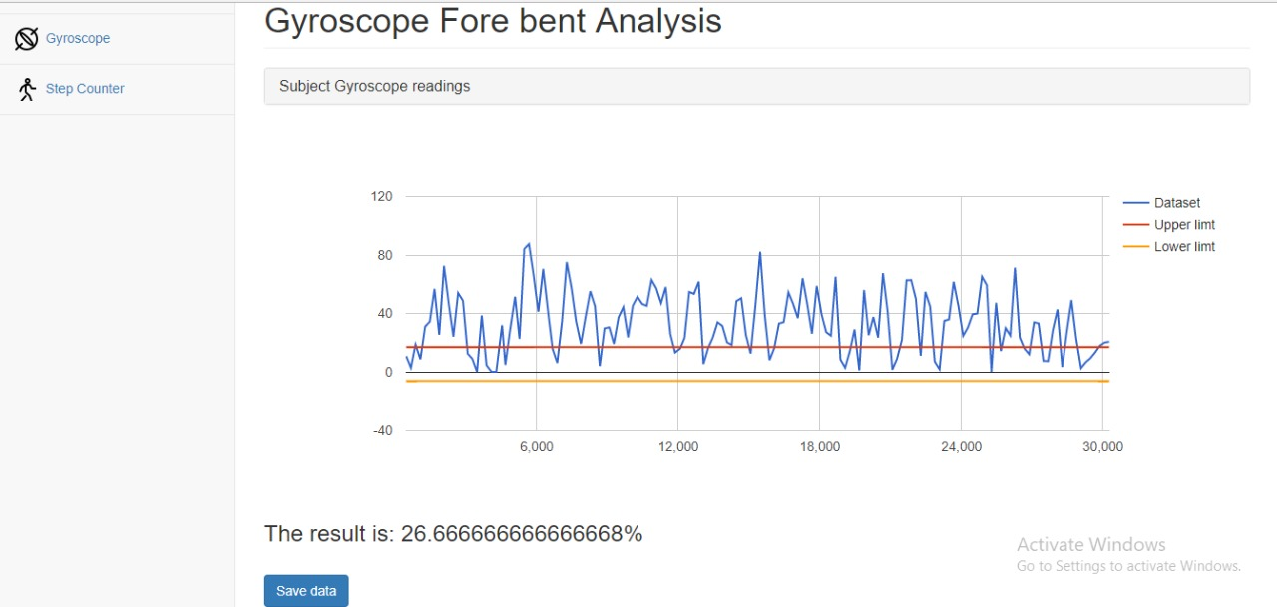
Result

Slide 9
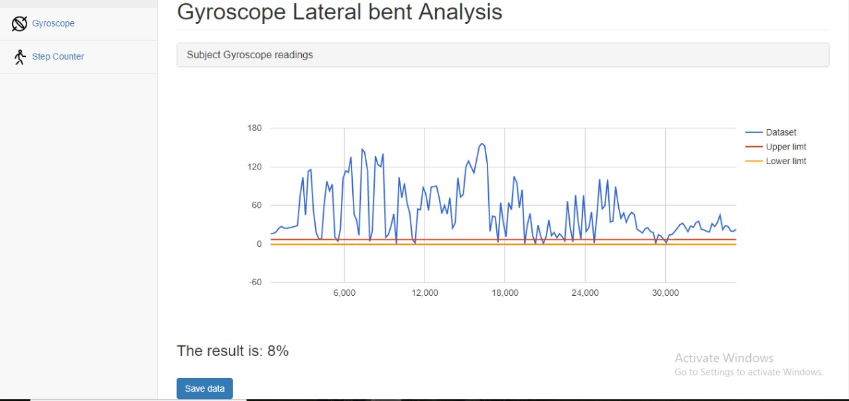
Result

Slide 10
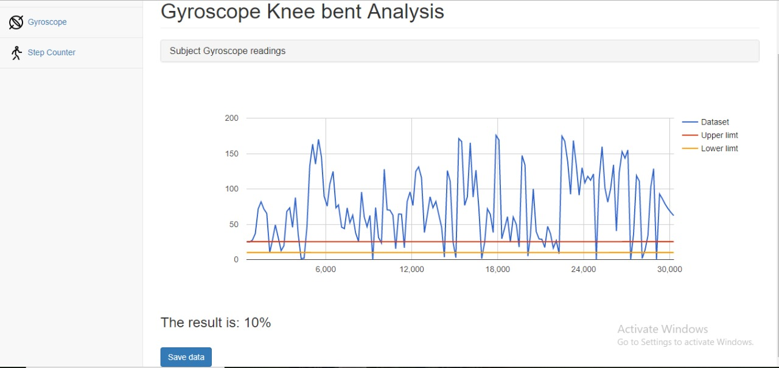
Result

Slide 11
Discussion
The dataset for different types of diseases is generally found in the form of a table with each patient have multiple measurements performed on him. We have chosen to measure the angle of the knee, the hip and the back. We have split the original dataset into the two red lines observed. This splitting was the margin for error. The blue part of the graph denotes the actual patient performing an activity for us to measure in real time. We had asked the patient to perform each activity for 30 seconds. The readings that we received were plotted and we observed the number of points of this plot that lie in between the two red lines. The probability that a person is afflicted with a neurodegenerative disorder was calculated by comparing the number of points lying in the region by the total number of observational points. Our threshold was 75%.

Slide 12
Benefits
Reduced cost
More flexibility in variable measurement
Portable system
Reduced complexity

